Slide 1
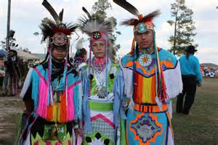
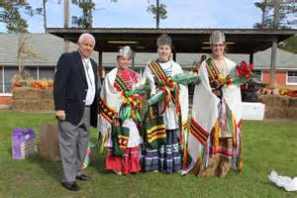

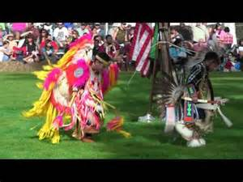
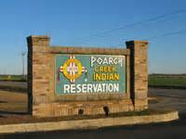

Slide 2
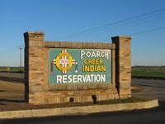
The Poarch Creek Indians are descendants of a segment of the original Creek Nation, which once covered almost all of Alabama and Georgia. Unlike many eastern Indian tribes, the Poarch Creeks were not removed from their tribal lands and have lived together for almost 200 years in and around the reservation in Poarch, Alabama. The reservation is located eight miles northwest of Atmore, Alabama in rural Escambia County, and 57 miles east of Mobile.

Slide 3
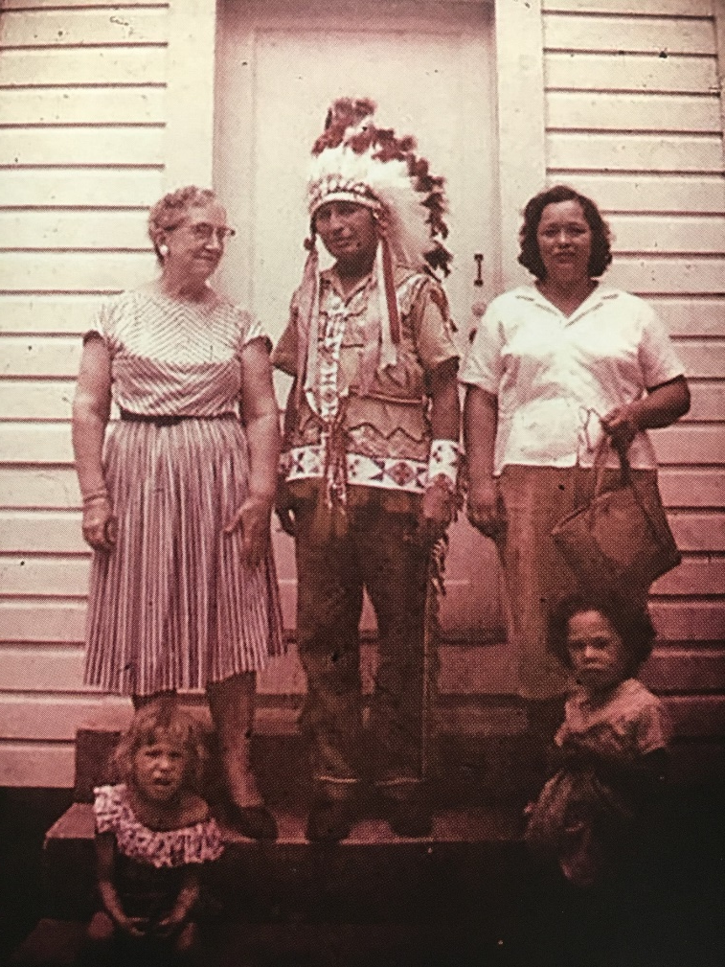
The Poarch Band of Creek Indians is the only federally recognized Indian Tribe in the state of Alabama, operating as a sovereign nation with its own system of government and bylaws. The Tribe operates a variety of economic enterprises, which employ hundreds of area residents. Poarch Creek Indian Gaming manages three gaming facilities in Alabama, including: Wind Creek Casino & Hotel, Atmore; Wind Creek Casino & Hotel, Wetumpka; and, Wind Creek Casino & Hotel, Montgomery. The Poarch Band of Creek Indians is an active partner in the state of Alabama, contributing to economic, educational, social and cultural projects benefiting both tribal members and residents of these local communities and neighboring towns.

Slide 4
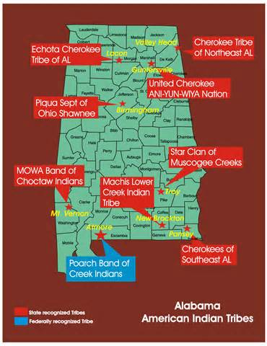

Slide 5
The Poarch Band of Creek Indians became Federally Recognized in August 1984; thus, allowing the Tribe to offer their membership more services.

Slide 6
Tribal Government Structure

Slide 7
LEGISLATIVE
A nine-member Tribal Council, one-third of whom are elected each year, meets regularly to manage Tribal affairs.

Slide 8
EXECUTIVE
The Tribal Chair is the CEO of the Tribe and is responsible for the overall management of the Tribal Government’s daily activities. Several departments perform administrative functions, including: accounting, human resources, education, family services, health services, safety, public works, utilities, economic development, legal, and resource development.

Slide 9
JUDICIAL
The tribal Supreme Court, Tribal Court, and Drug Court make up the Judicial Branch of the Tribe. The judicial system is an important exercise of Tribal sovereignty, as the state of Alabama has neither criminal nor civil jurisdiction over Indians located on the Reservation. The Federal Court System only has judicial authority over major criminal offenses that occur on the Reservation.

Slide 10
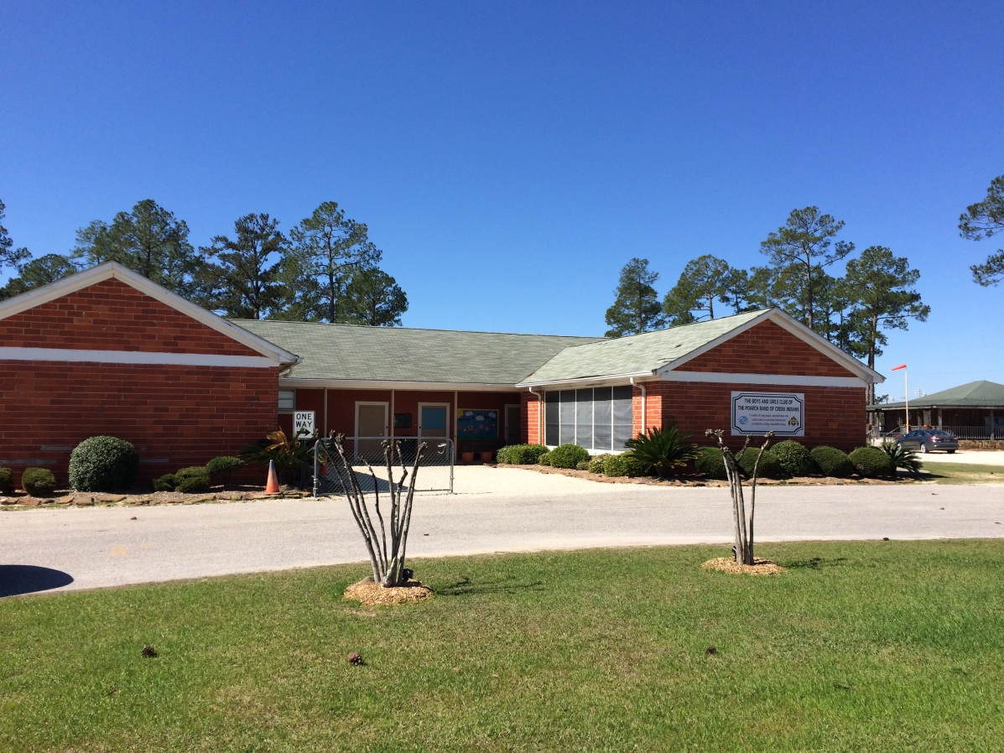
Our Beginning…
Old School House
Poarch, Alabama

Slide 11
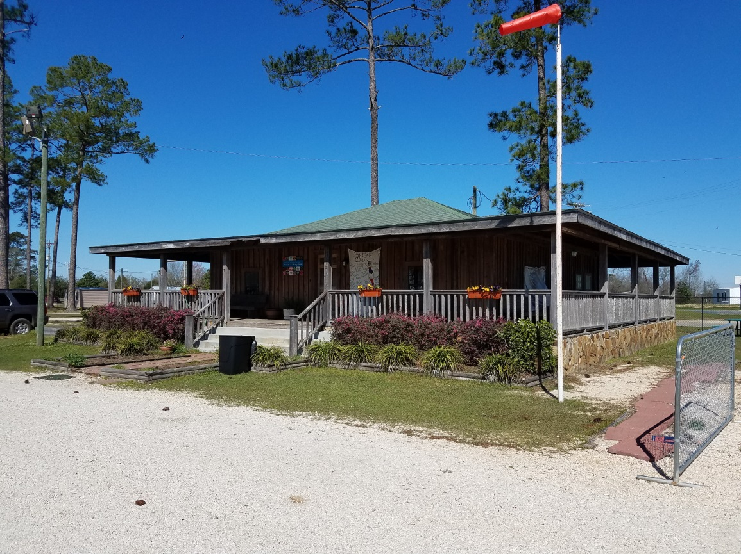
The Pickrell House
Poarch, Alabama

Slide 12
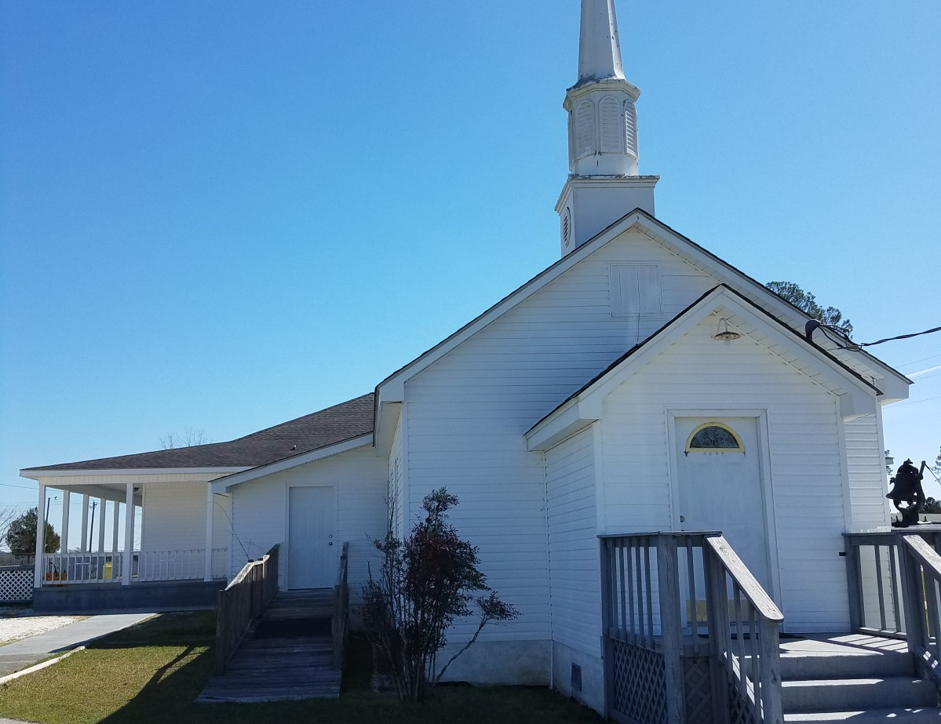
St. Anna’s Episcopal Church
100 Lynn McGhee Drive
Atmore, AL

Slide 13
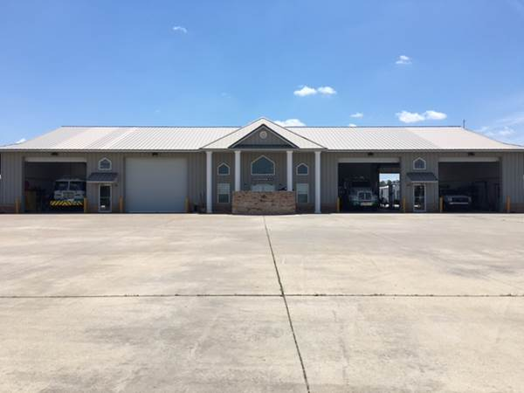
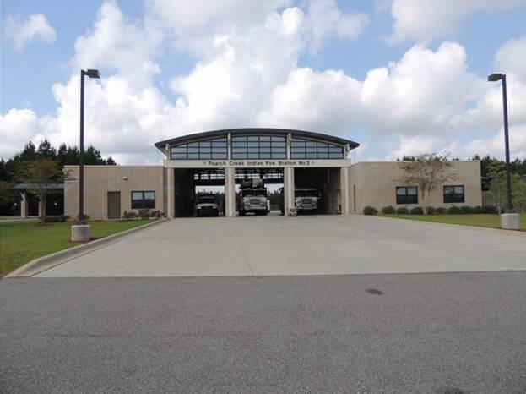
Modern Times …
Fire Station #1
Fire Station #2

Slide 14
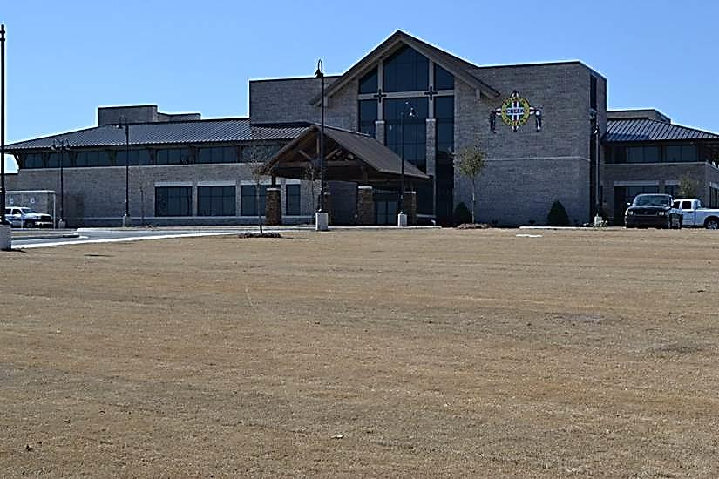
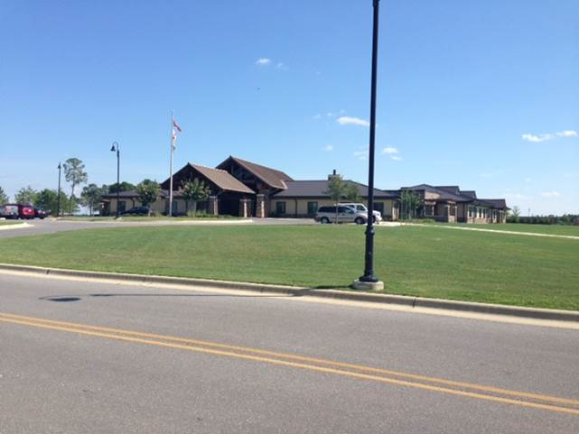
Lavan Martin Assisted
Living Facility
Buford L. Rolin
Health Department

Slide 15
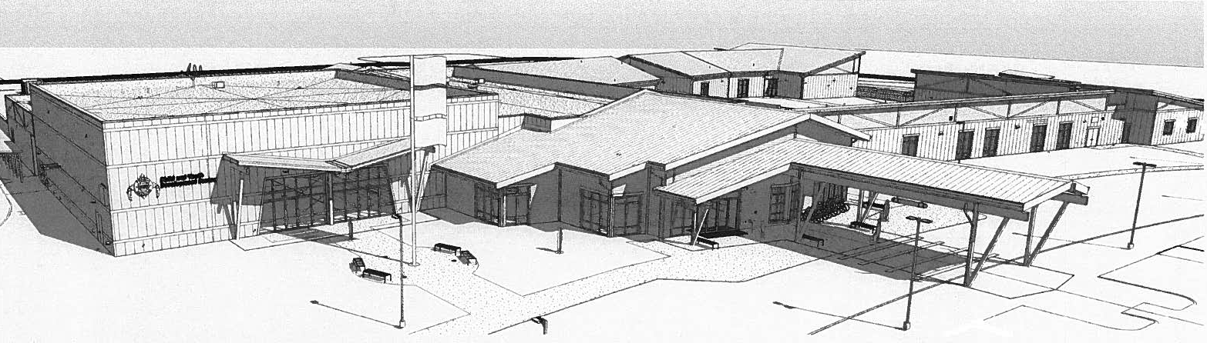
Poarch Creek Community Center
Grand Opening held March 1, 2018

Slide 16
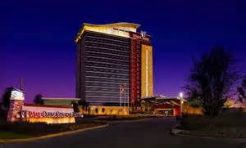
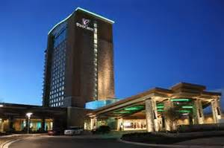
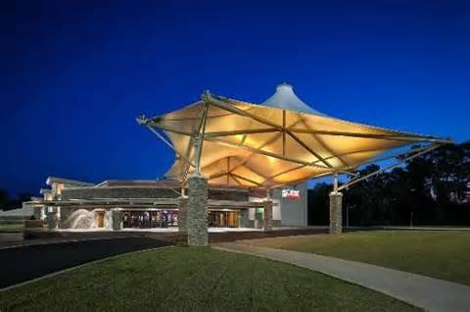
Wind Creek Hospitality

Slide 17
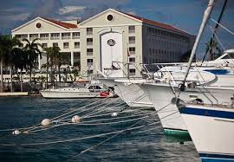
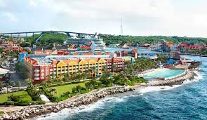

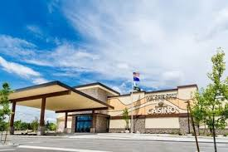
Wind Creek Hospitality

Slide 18
Creek Indian Enterprises

Slide 19
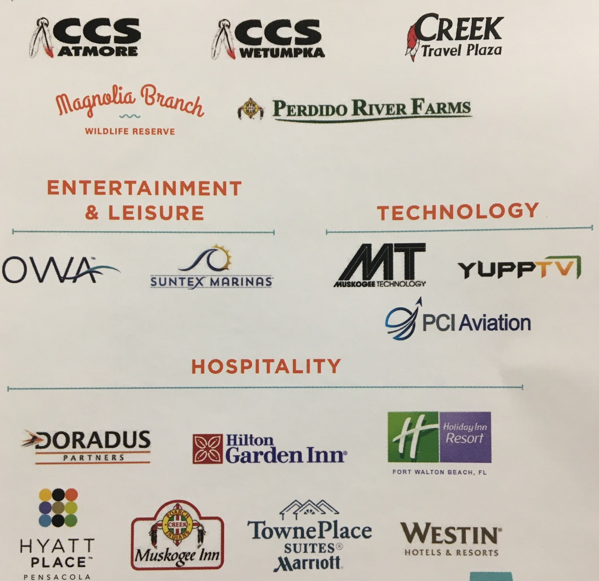

Slide 20

Fire Department 25
Police Department 55

Slide 21
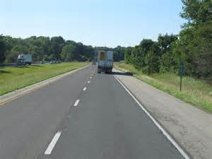
I-65

Slide 22
2009 Dragon Slayer
Civil Support Team

Slide 23
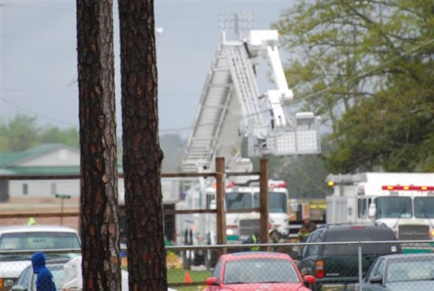

Slide 24
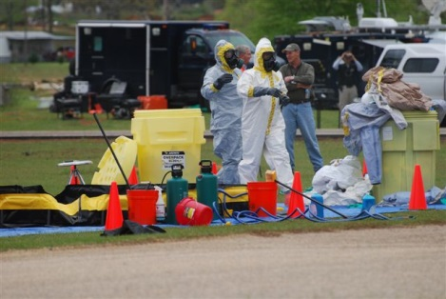

Slide 25
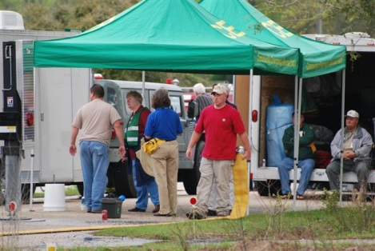

Slide 26
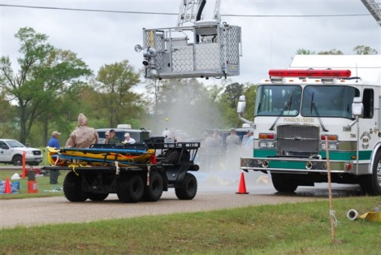

Slide 27
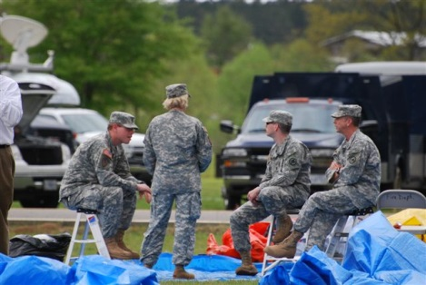

Slide 28
2017 Alabama National Guard Exercise

Slide 29
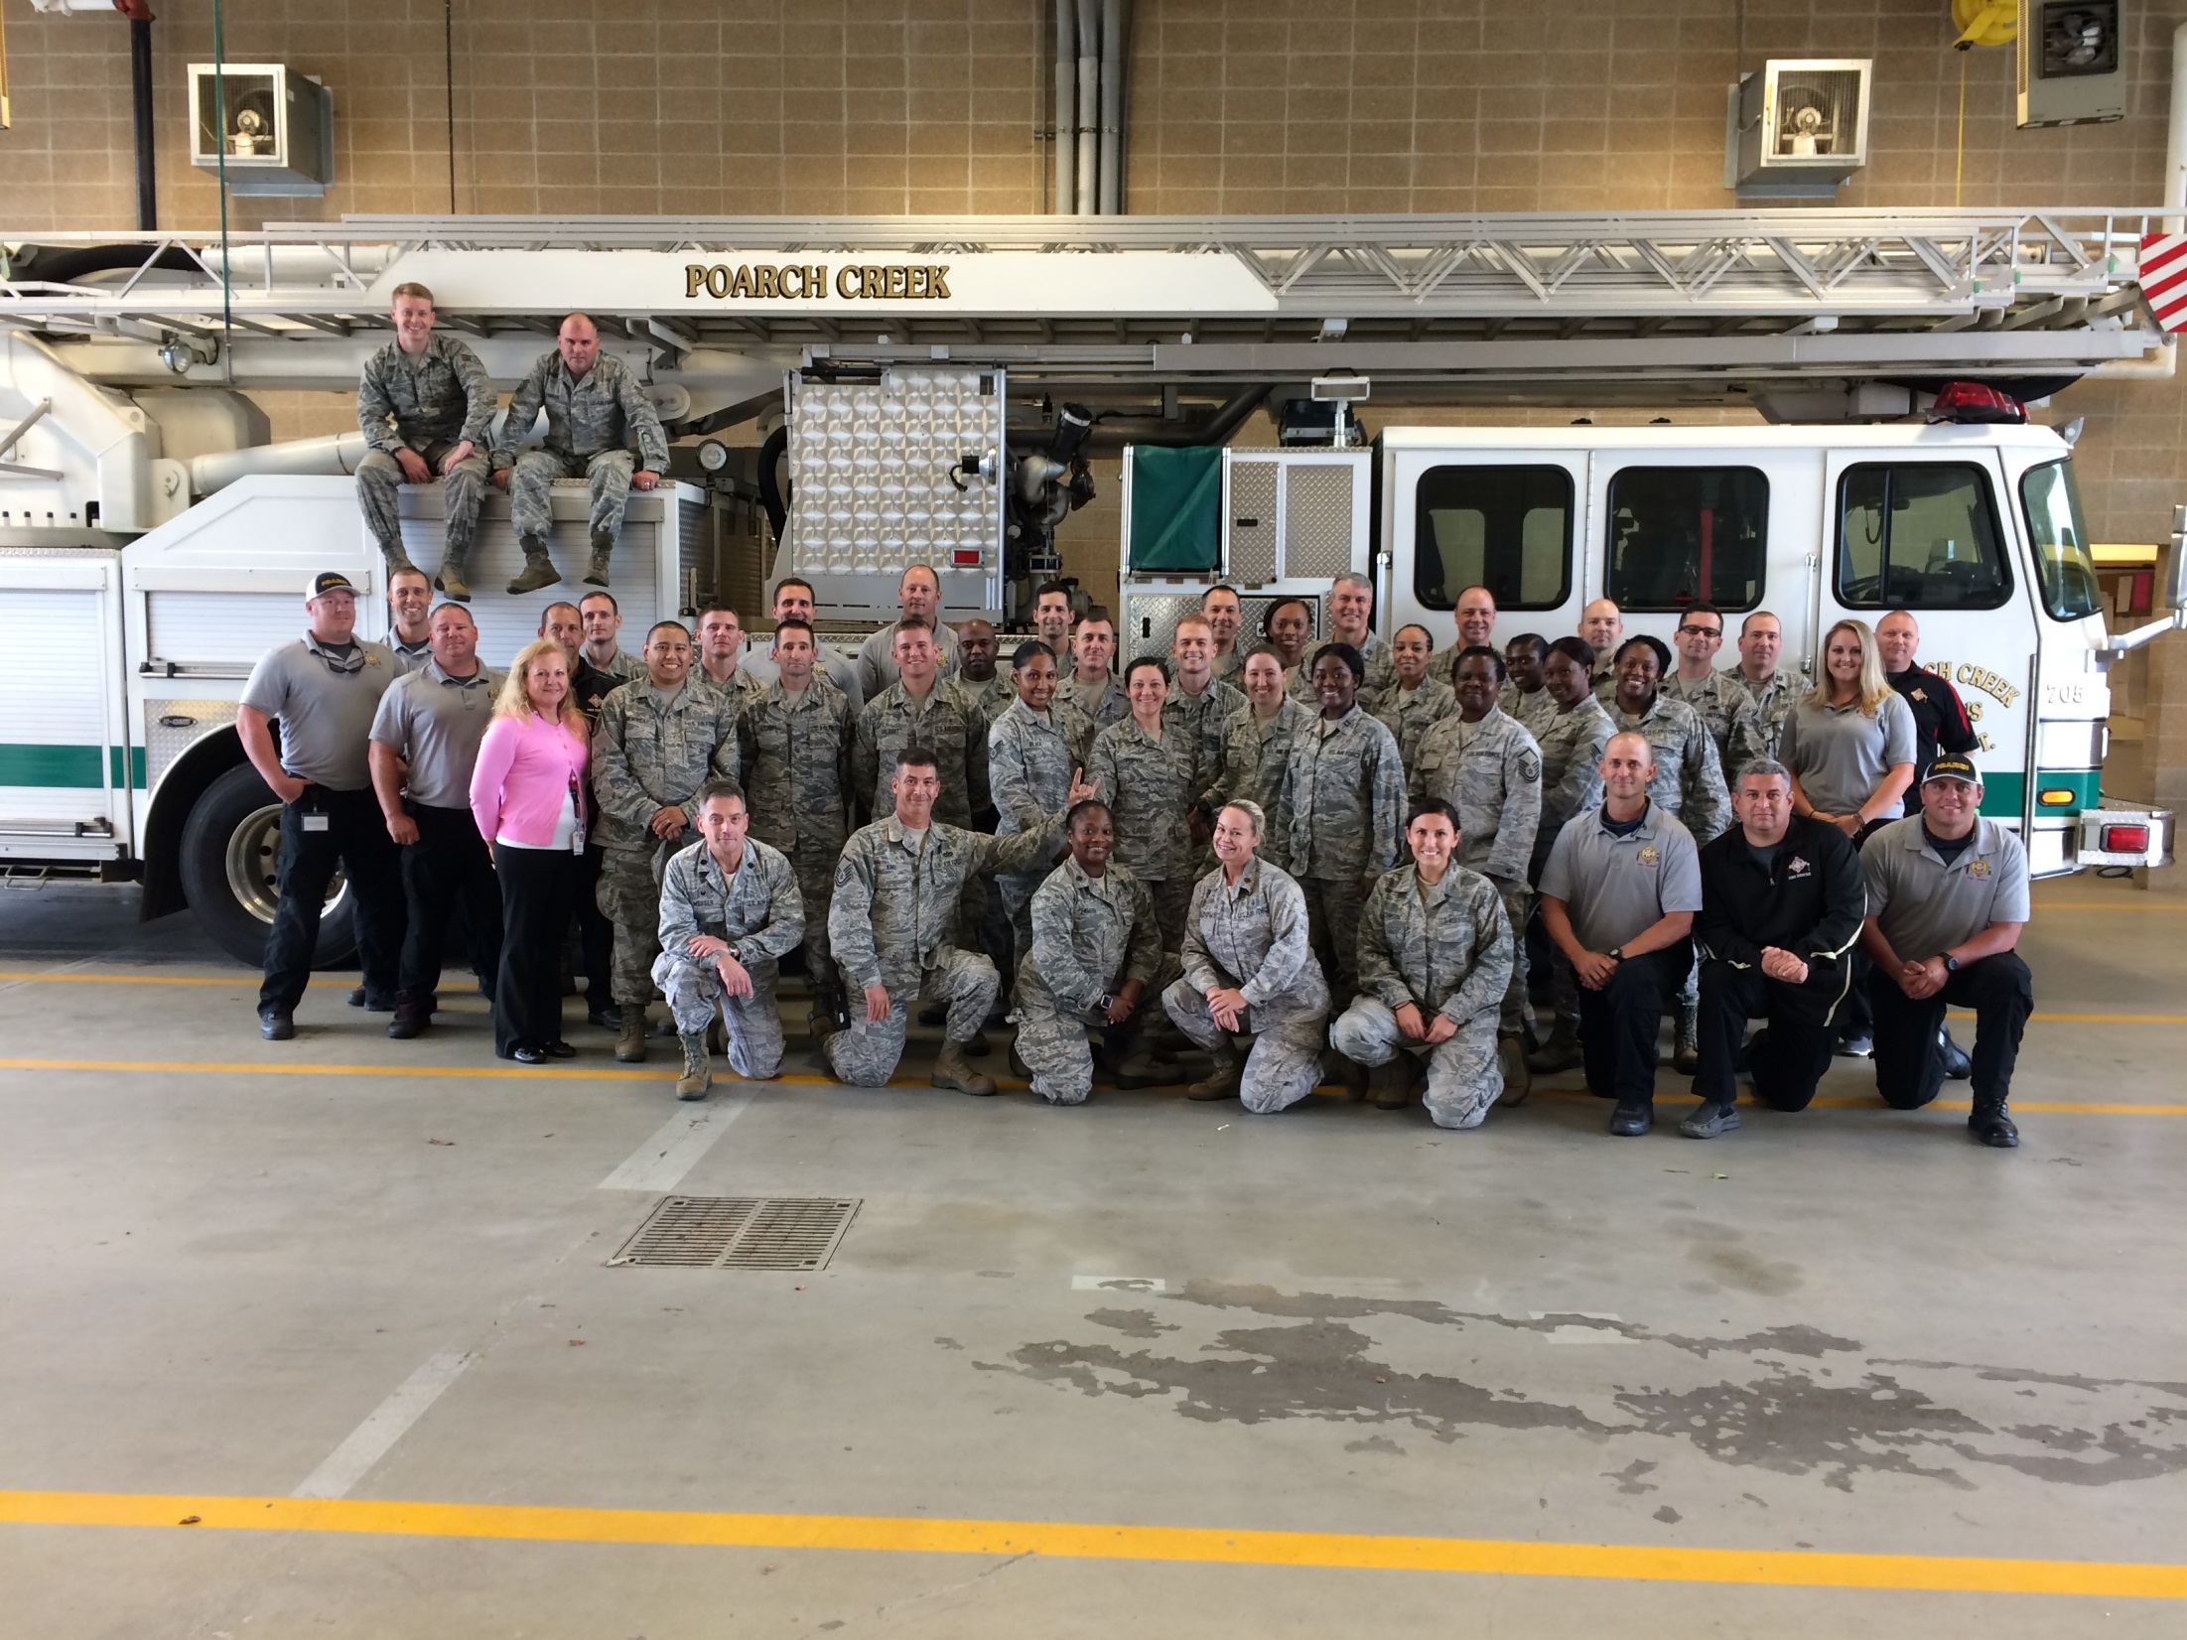

Slide 30
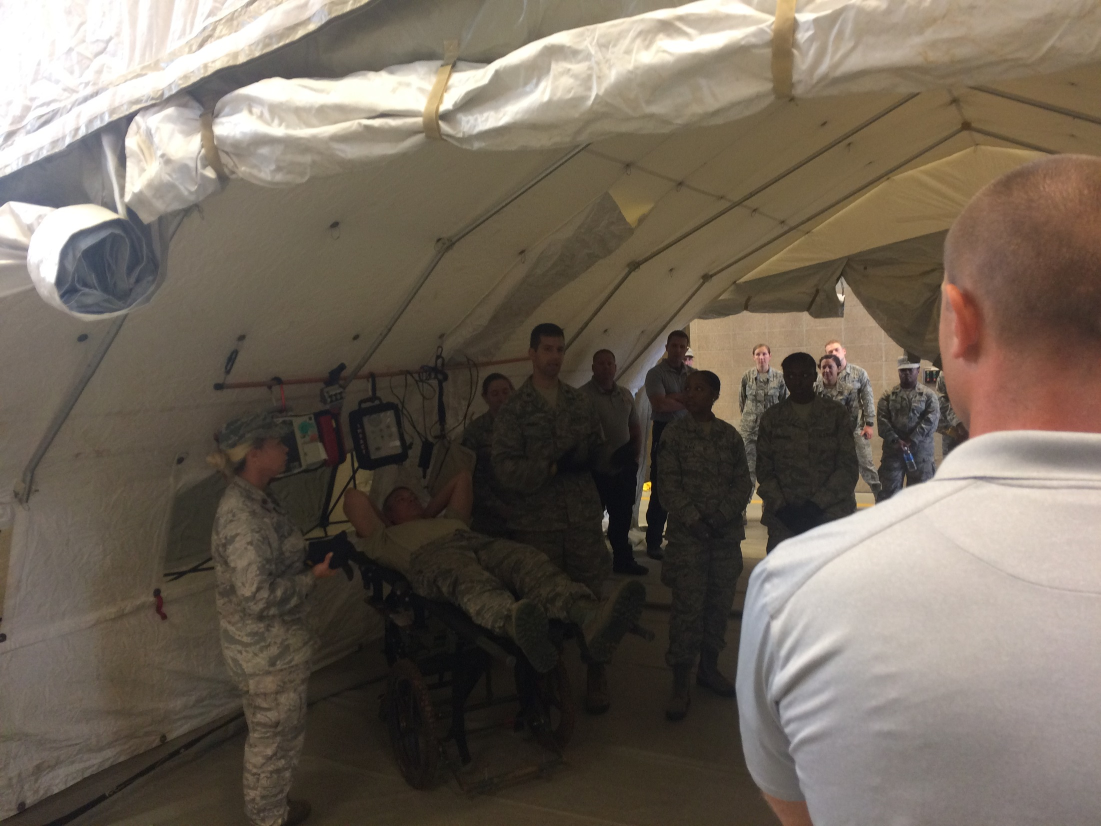

Slide 31



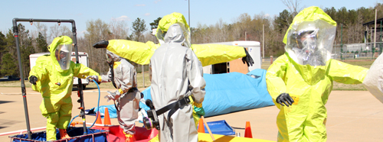
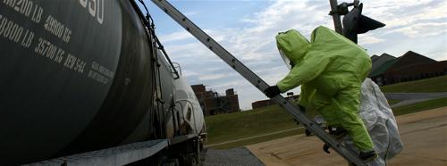
Hazardous Materials Awareness & Operations
Hazardous Materials Technician
Hazardous Materials Incident Commander

Slide 32
National Domestic Preparedness Consortium

Slide 33

National Center for Biomedical Research and Training at Louisiana State University
PER-229 | Introduction to Computer-Aided Management of Emergency Operations (CAMEO) Suite
PER-222 | Public Safety CBRNE Response - Sampling Techniques and Guidelines

Slide 34
PER-354
Response to Radiological/Nuclear Weapons of Mass Destruction Incidents

Slide 35

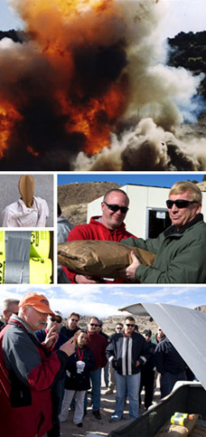
Incident Response to Terrorist Bombings (IRTB)

Slide 36
Texas A&M Engineering Extension Service, National Emergency Response and Rescue Training Center
Medical Preparedness And Response For Bombing Incidents-MGT348
Intermediate ICS-300 For Expanding Incidents-MGT904
Advanced ICS-400 Command And General Staff-Complex Incidents-MGT 905

Slide 37
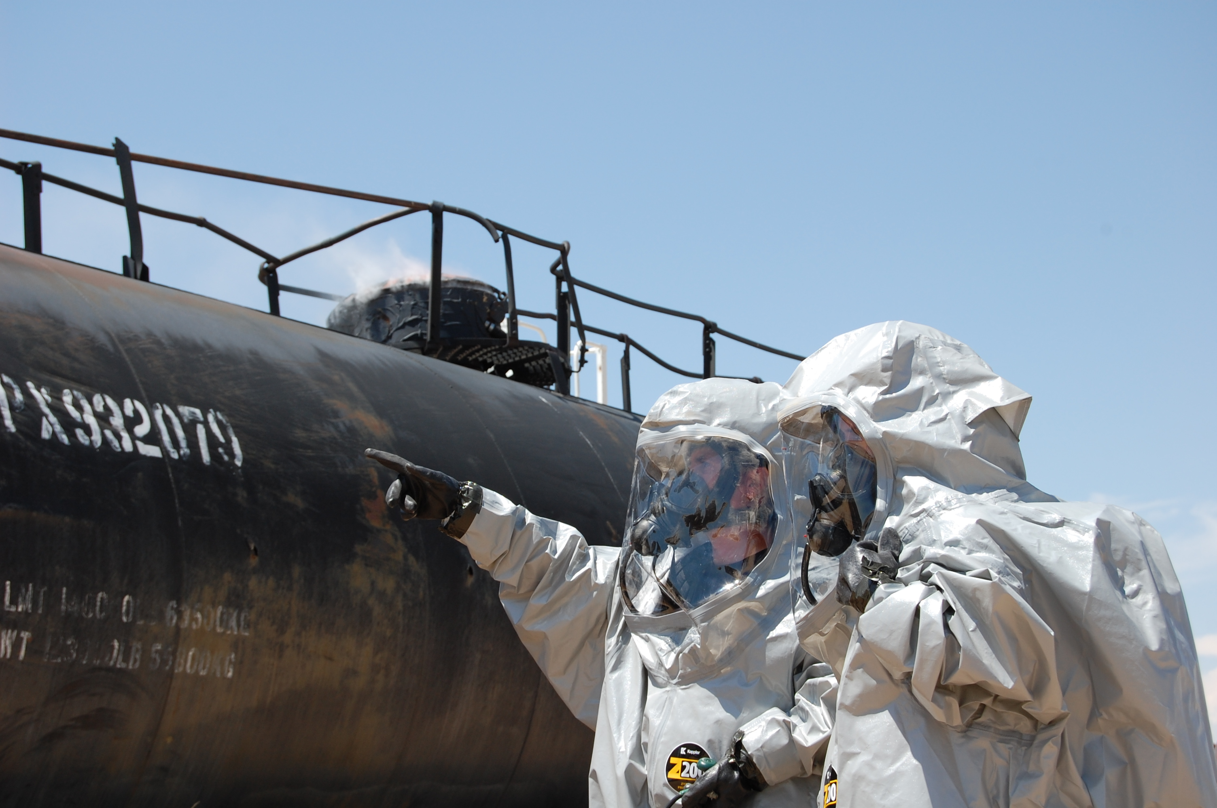
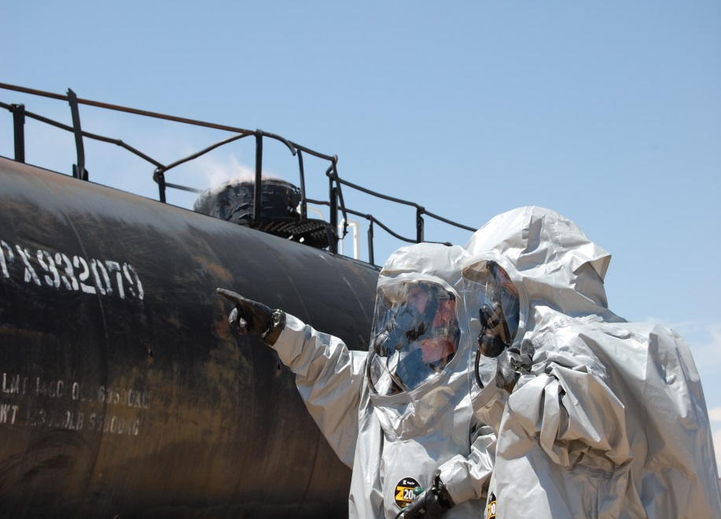
Transportation Technology Center, Inc., Security and Emergency Response Training Center
TANK CAR SPECIALIST (TCS) — PER-290

Slide 38
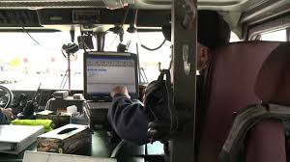
Mobile Data Terminal

Slide 39


https://erplan.net
https://wiser.nlm.nih.gov/

Slide 40
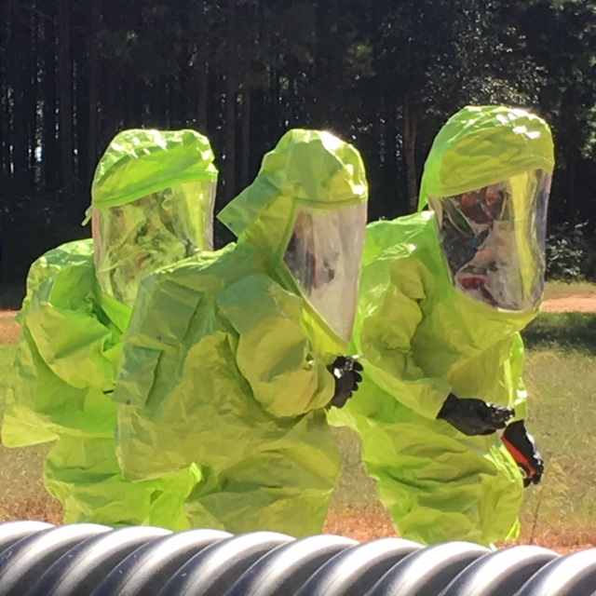
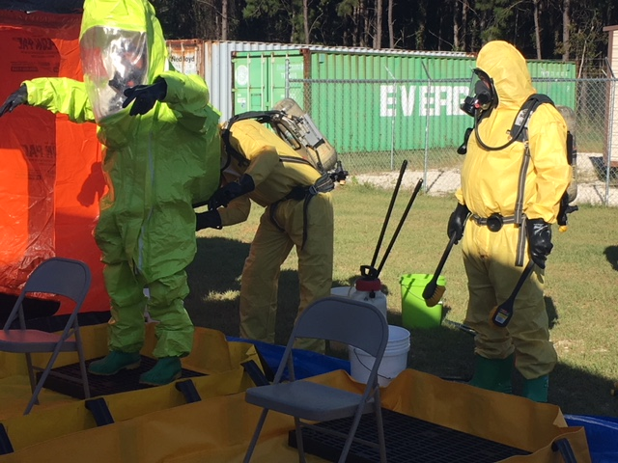
RESPONSE

Slide 41
Contractual Services Provided By…

Slide 42
Questions?

